Slide 1
Continuous Authorisation For Subject-centric Data Sharing
By: Paul Sarda, Jabbed Morsherd Alan Coleman
Swinburne university of technology

Slide 2
Structure of prestation
Introduction
Motivation
IOT based services for contextual information
Use case
Implementation
Conclusion
Questions answer
Notes:
What is data centeric sharing
What is contus authrsation
How Iot devices can be utislied for conextical information
Some use cases this system
About the implemneation I created
Then questions

Slide 3
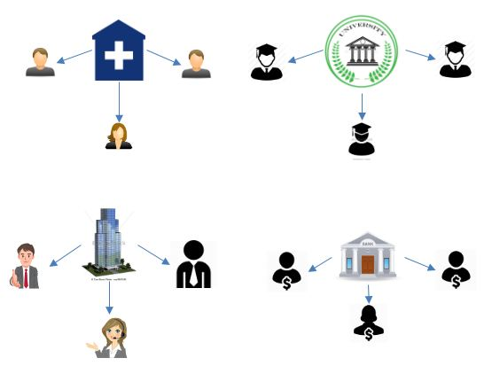
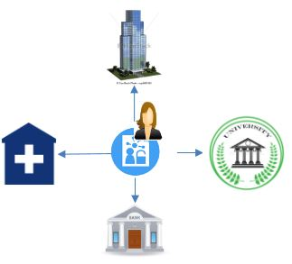
Subject Centric Data Sharing
Traditional System
Subject Centric system
Notes:
Subject centric system subject can share their information iresspective of the platform removing the addmistive boundy
In subject centric data sharing the data subject can share their data from a common platrom irespetiec of the data cusdiation which is hosting theirdata

Slide 4
Objectives of subject centric data sharing
In Subject-centric data sharing individuals want to achieve
Context – aware sharing
Privacy persevering sharing
Resharing of data
continuous authorization
Notes:
* Contex –aware: sharing data with extinral conex provider

Slide 5
Continuous authorisation
Authorisation decision is checked at a predefined interval
This is checkered by an authorisation manger
Only certain Attributes of the authorisation policy are checked

Slide 6
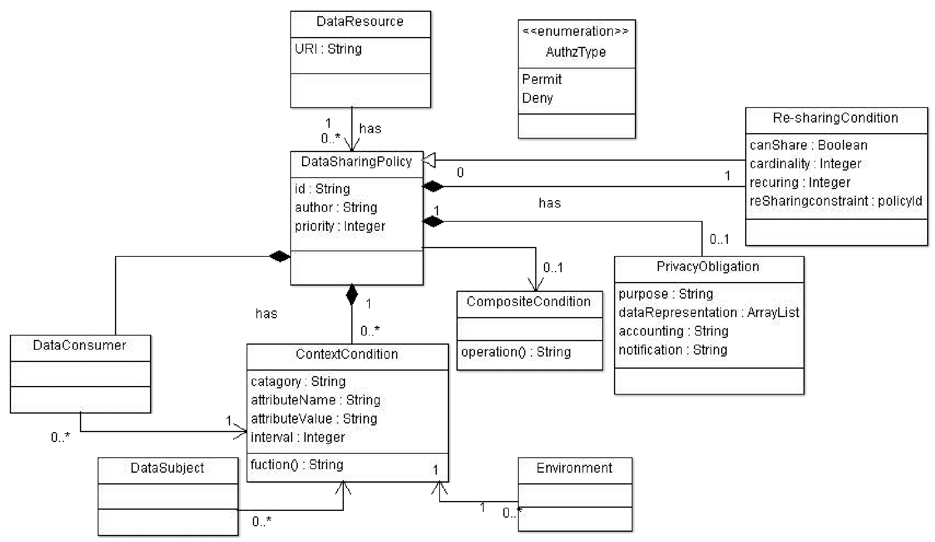
Continuous authorisation

Slide 7
IOT based services for contextual information
Different IOT devices contains different kinds of sensors, which provided different kinds of contextual information
Such as
Location
Heart rate
Light sensor
Blood pressure
Temperature
Different IOT devices may have the same sensors but different data representation

Slide 8
Use Case
Location sharing with Ip camera

Slide 9
Use Case
Heart rate paramedics

Slide 10
Use Case
Sleep Video camera sharing

Slide 11
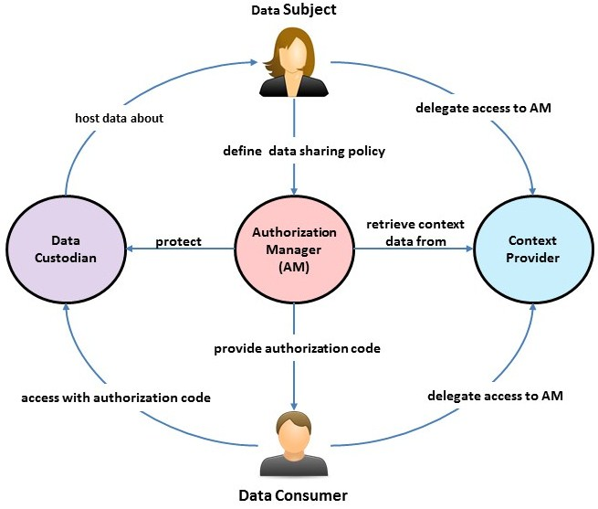
Implementation
Comprised of serval programs
Policies
Attempted to recreate two use cases
Sharing an Ip camera feed when the data subject is not home (live data)
Benchmarking

Slide 12
Implementation - Programs
Authorisation manger
prototype context provider library
Rest API Server
policy creation web page
Benchmarking application
Example data custodians page
Contunisus data resource example page
Companion applications
Android application
Tizen OS application

Slide 13
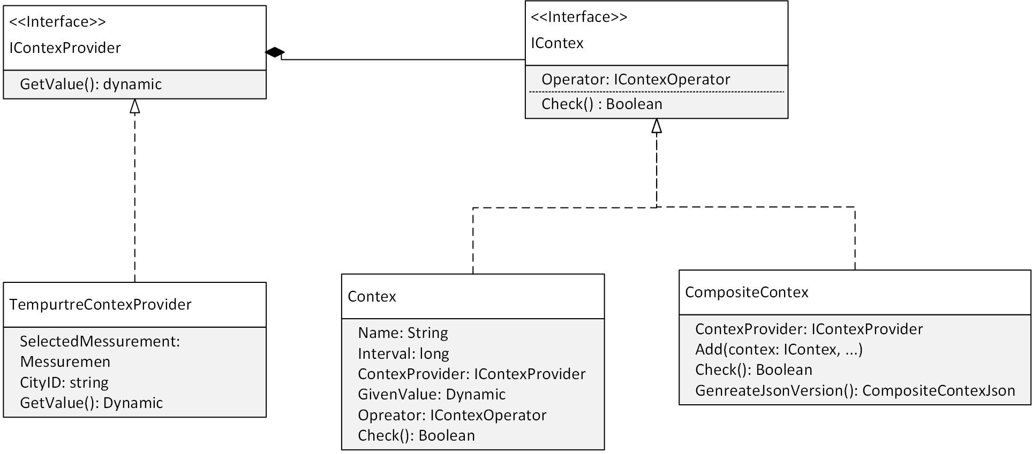
Implementation - Polices
Polices are implemented as C# classes
These classes can be serialised and deserialised by the newtonsoft Jsonconvertion library
Utilises Context providers
Stuchute listed to the right
Example policy next slide

Slide 14
Example Policy
{
"Author": "Not paul", "Proity": 0, "Decision": "Sharing ip camrea",
"DataConsumer": { "Name": "paul ", "Value": "pfsarda23@gmail.com" },
"PrivacyOblgations": { "Purpose": "View my IP camrea when im not home", "Granularity": "None", "Anonymisation": "None", "Notifaction": "None", "Accounting": "None“ },
"ResharingObligations": { "CanShare": false, "Cardinality": 0, "Recurring": 0 },
"JsonCompositeContex": {
"Conteiexs": [
{
"Contex": {
"Name": "TempTest",
"Interval": 100,
"ContextProvider": {
"$type": “…",
"URL": "https://restserver.conveyor.cloud/api/watch/GetLocation/zibqmpenzd"
},
"GivenValue": { "$type": “…", "Lat": -37.83933, "Lon": 145.2042165},
"IContexOperator": { "$type": “…", "Radius": 100 }
},
"Glue": 0,
"Not": false
}
]
}
}

Slide 15
Implementation – Demonstration
Video recoding of demo

Slide 16
Implementation – Benchmark
Notes:
REPLACE 2nd CHART with LOADED VS UNLOADE

Slide 17
Limitations
Implementation related
Only a single AM exists in our system but was design so the URL could be changed
Conunteus checking is completed on client side live data version need to be created
Tokens do not expire
Resharing is not implemented

Slide 18
Conclusion

Slide 19
Thank you for your time
Questions?

